Slide 1
Covid-19 in India Data Analysis & Visualisation using PYTHON
Rashmiranjan Rout (180301160033)

Slide 2
INTRODUCTION
Coronavirus disease (COVID-19) is an infectious disease caused by the SARS-CoV-2 virus.
Most people who fall sick with COVID-19 will experience mild to moderate symptoms and recover without special treatment. However, some will become seriously ill and require medical attention.
HOW IT SPREADS
The virus can spread from an infected person’s mouth or nose in small liquid particles when they cough, sneeze, speak, sing or breathe. These particles range from larger respiratory droplets to smaller aerosols.
You can be infected by breathing in the virus if you are near someone who has COVID-19, or by touching a contaminated surface and then your eyes, nose or mouth. The virus spreads more easily indoors and in crowded settings.

Slide 3
Data source
Links:
https://www.kaggle.com/sudalairajkumar/covid19-in-india?select=covid_19_india.csv
Data sets: Jan 2020 to Aug 2021
Covid_19_india
Latest covid_19 India status
Covid_vaccine_statewise

Slide 4
Objectives
Top 10 state with most covid cases from Jan 2020 to Aug 2021
Highest 50 test samples collected
State wise Resources (beds, ICUs and ventilators) available
Top 10 populated state affected by covid-19 .
Vaccination done per day for a month(Dose1 & Dose2)
Total Vaccination done till date(male, female- covaxin and covishield)

Slide 5
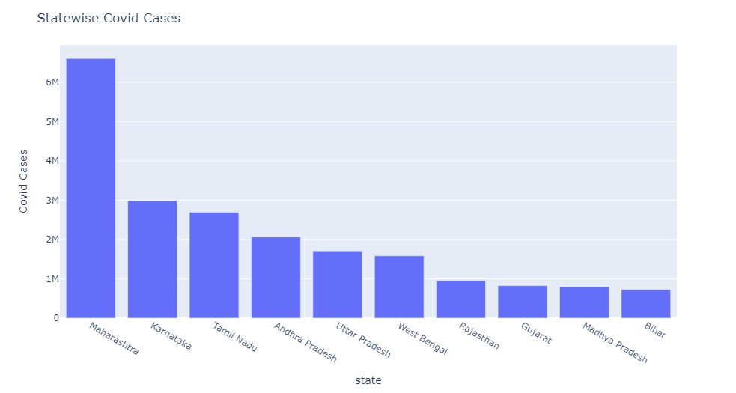
Top 10 state with most covid cases from Jan 2020 to Aug 2021

Slide 6
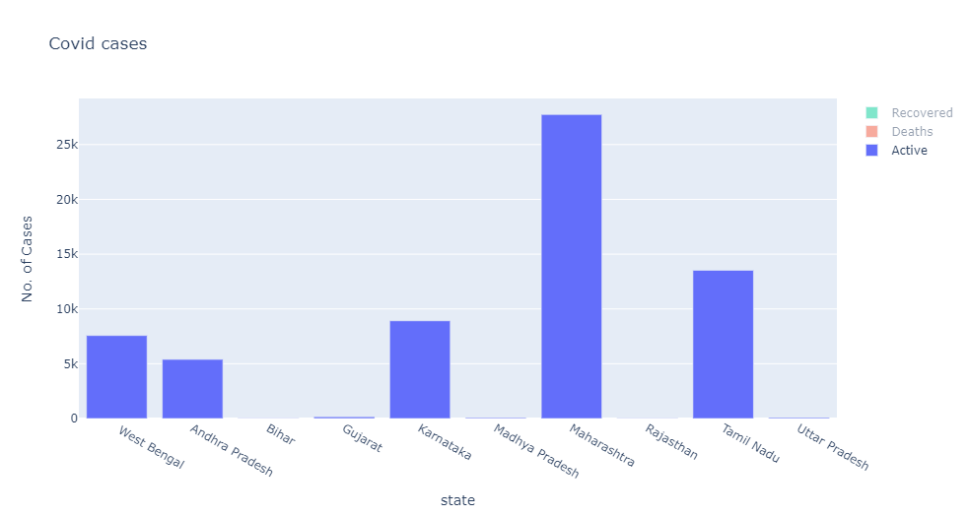

Slide 7
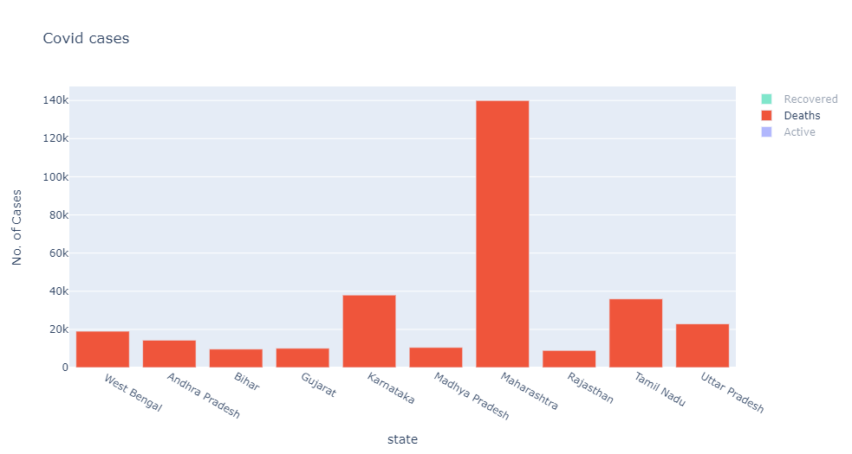

Slide 8
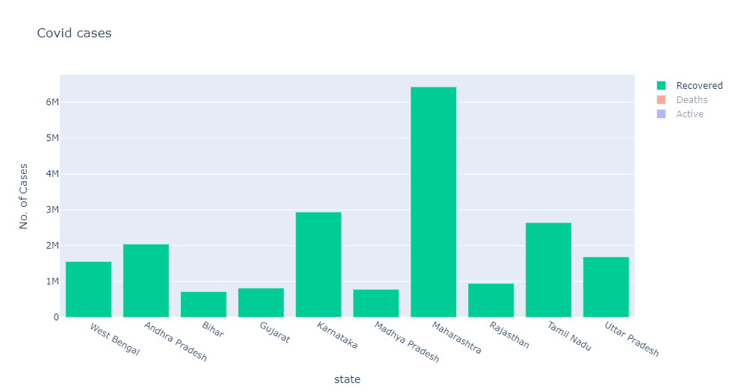

Slide 9
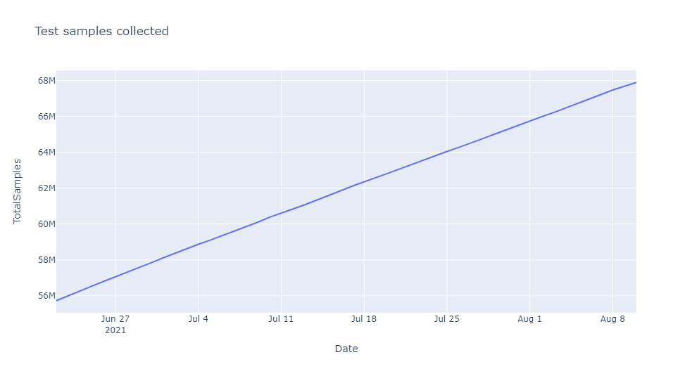
Highest 50 test samples collected

Slide 10
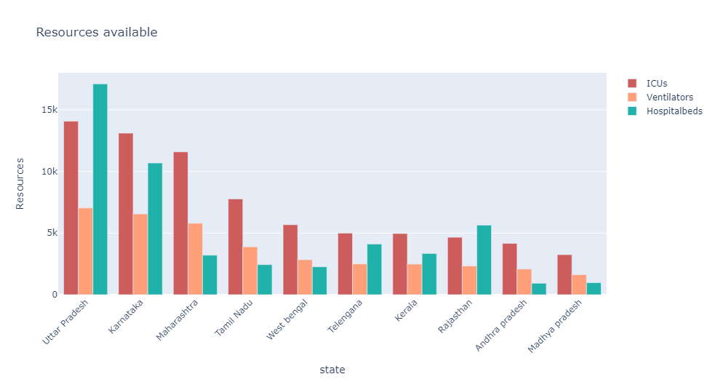
State wise Resources (beds, ICUs and ventilators) available

Slide 11
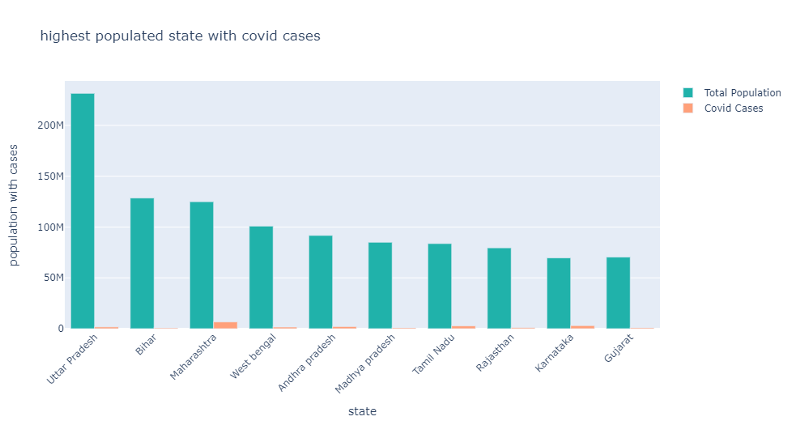
Top 10 populated state affected by covid-19

Slide 12
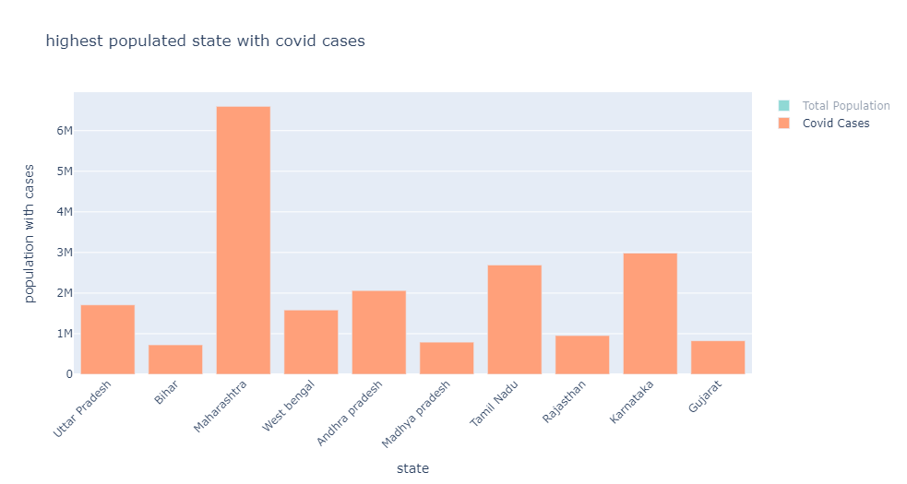

Slide 13
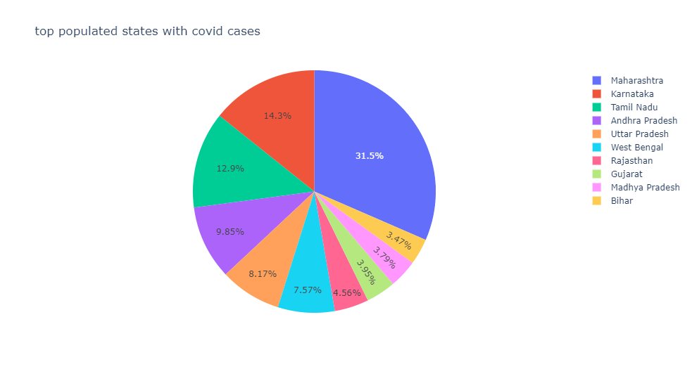

Slide 14
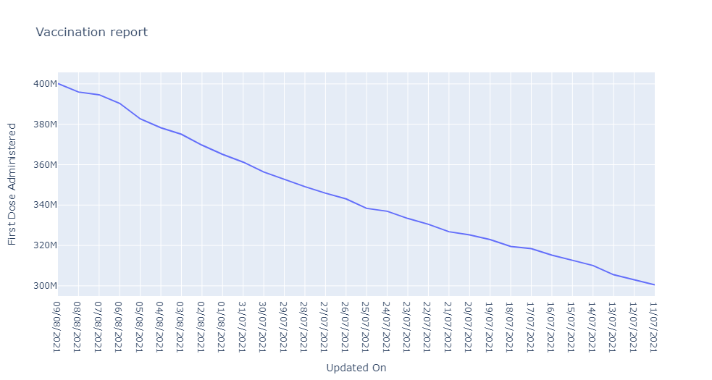
Vaccination done per day for a month(Dose1 & Dose2)

Slide 15
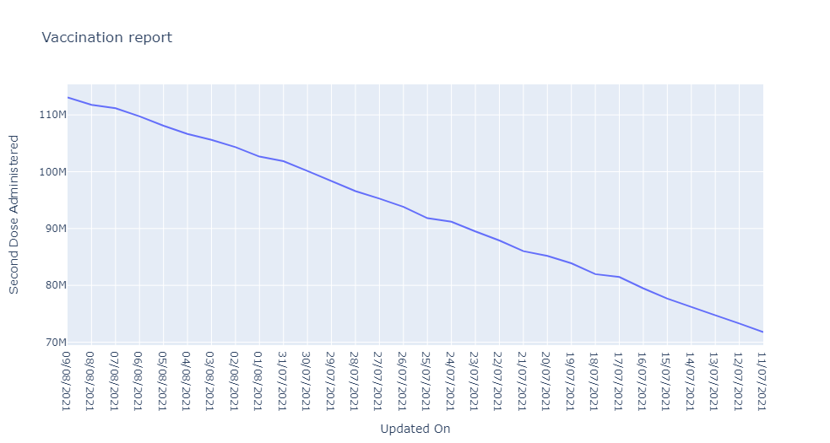

Slide 16
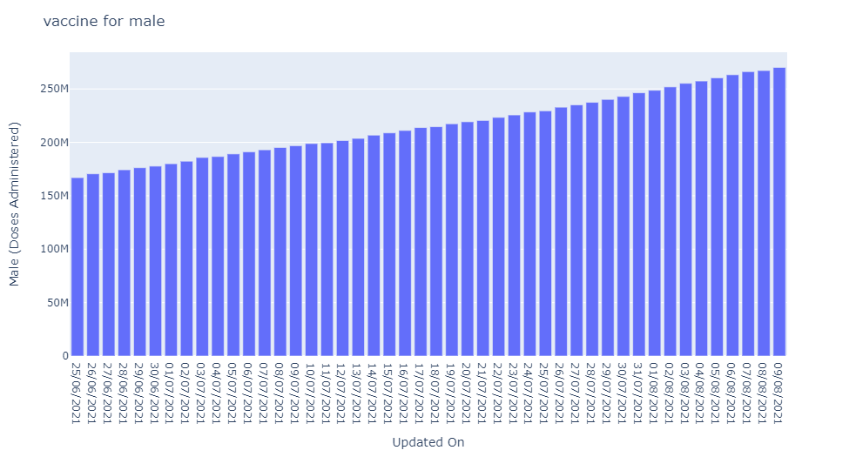
Total Vaccination done till date(male, female- covaxin and covishield)

Slide 17
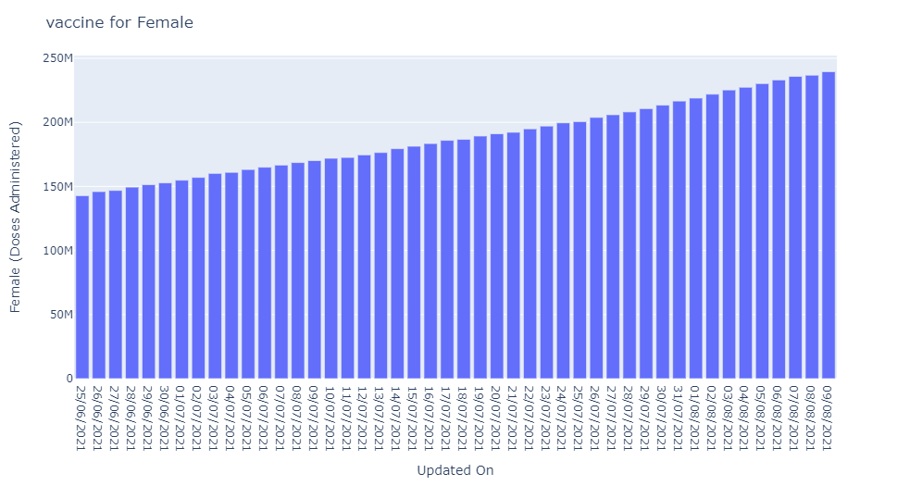

Slide 18
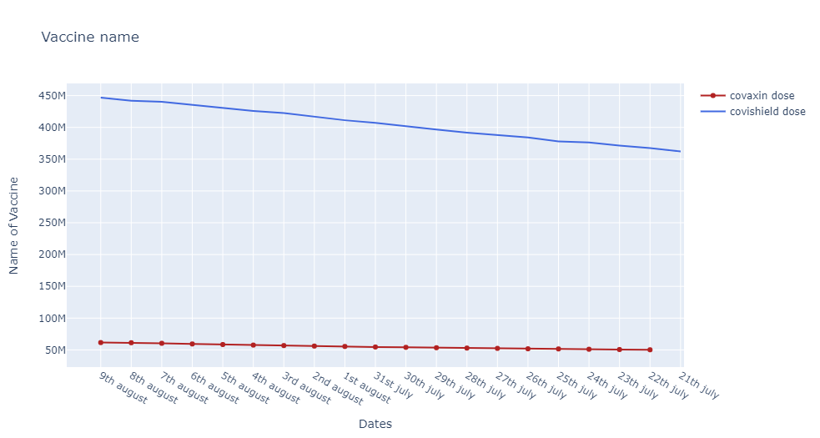

Slide 19
Conclusion
Conducting Census using traditional approach amidst COVID-19 pandemic led to adjustment in methods, procedures and collection tools
To reduce pandemic impact on overall census product and ensure comparability of data overtime
Enhancement in metadata to assist users in understanding unusual patterns

Slide 20


